Slide 1

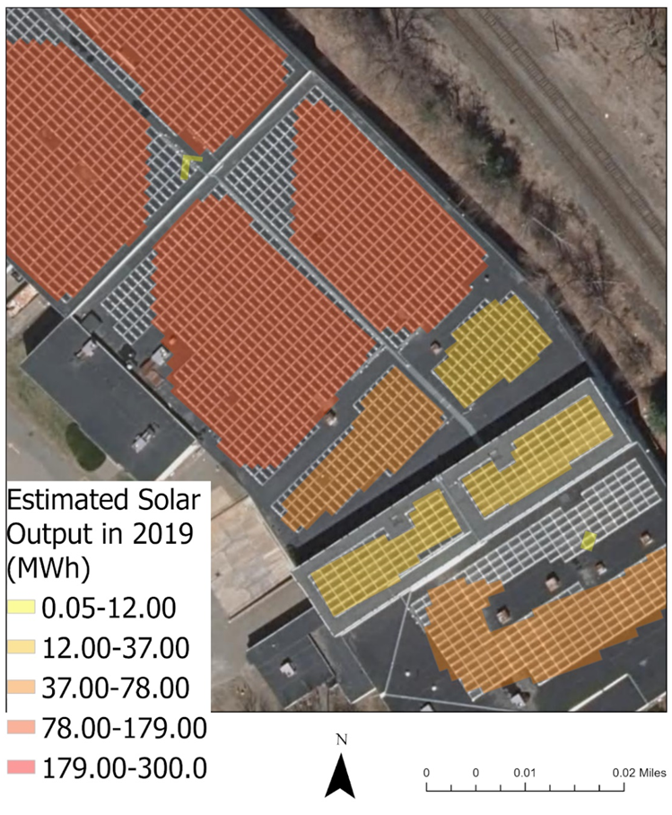
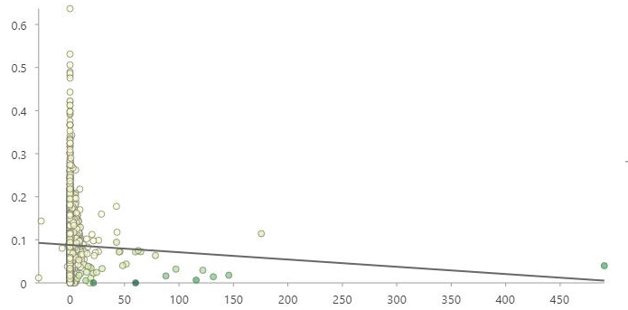
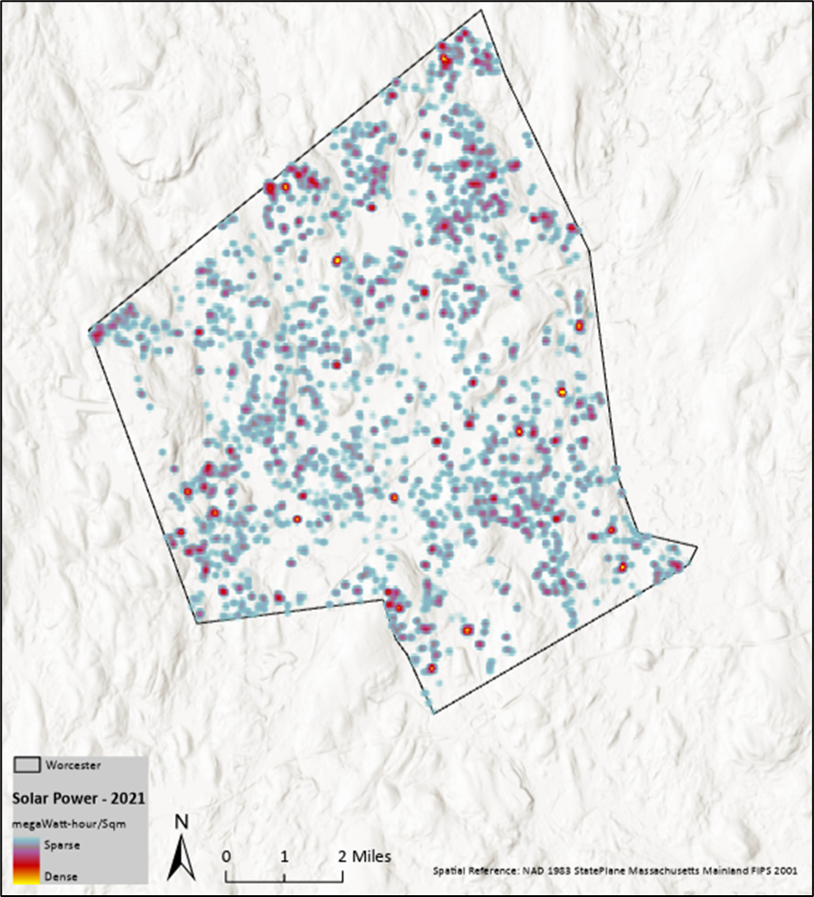
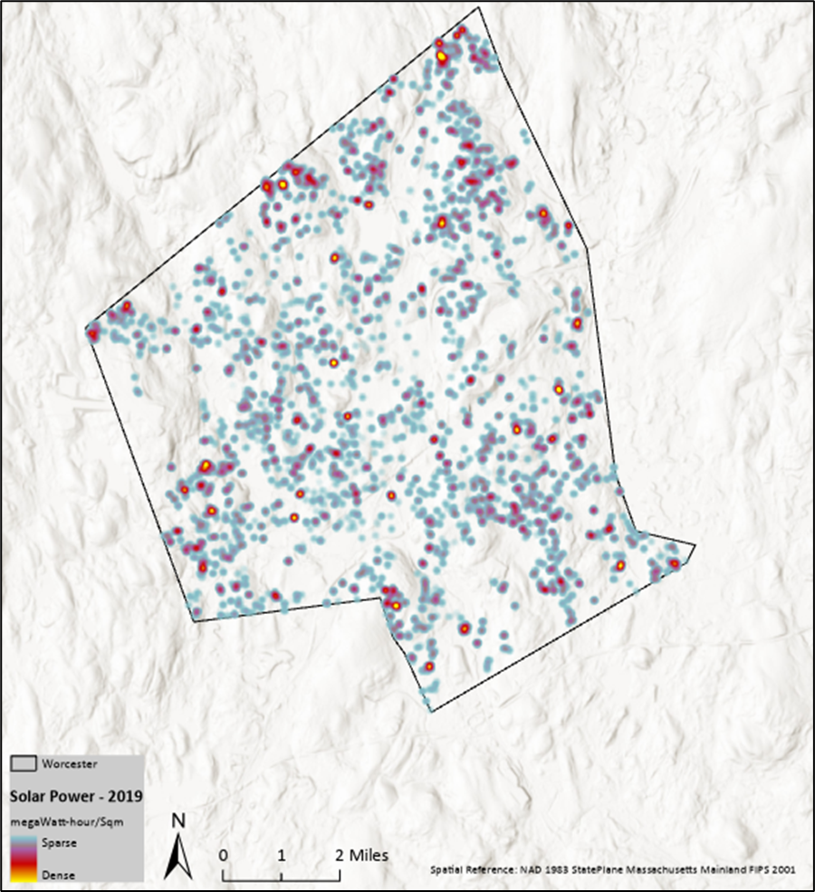
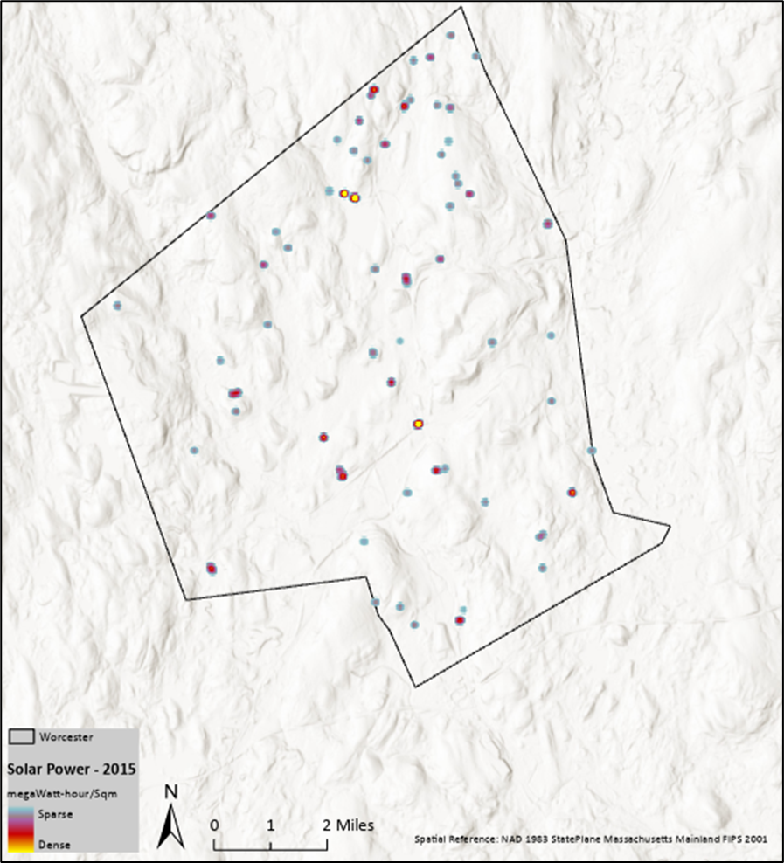
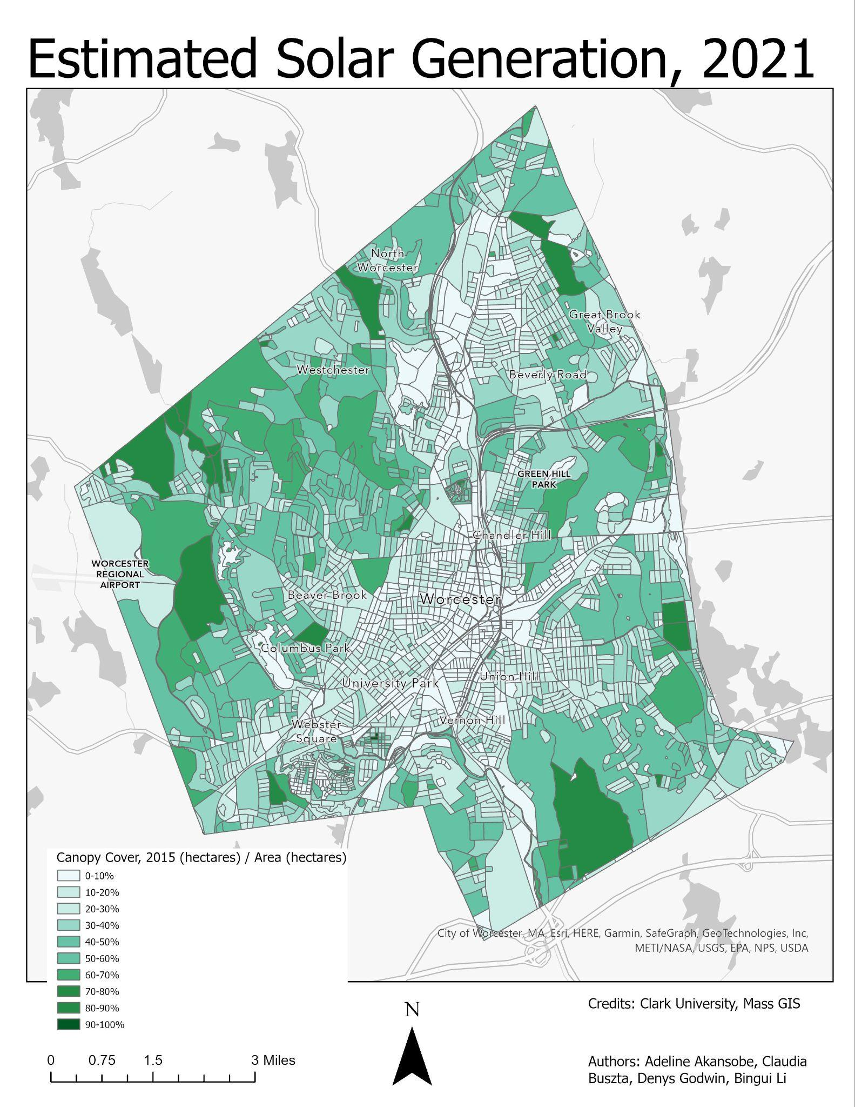
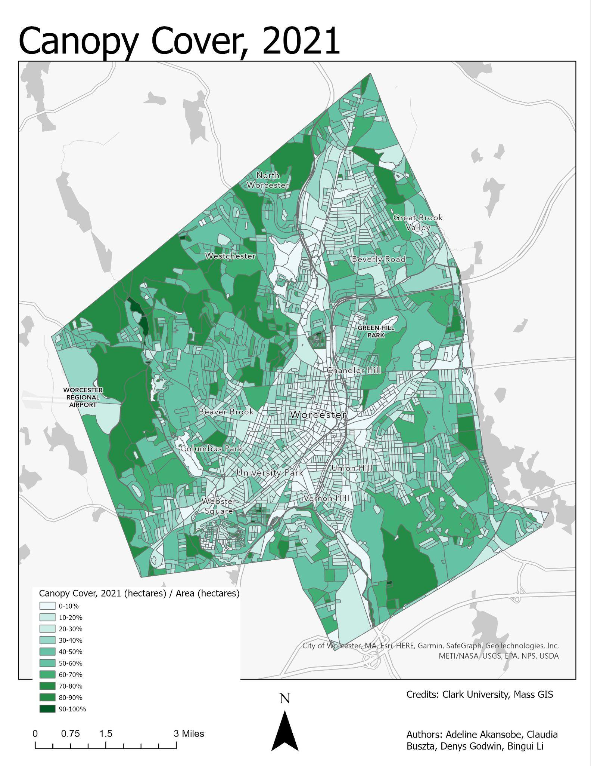
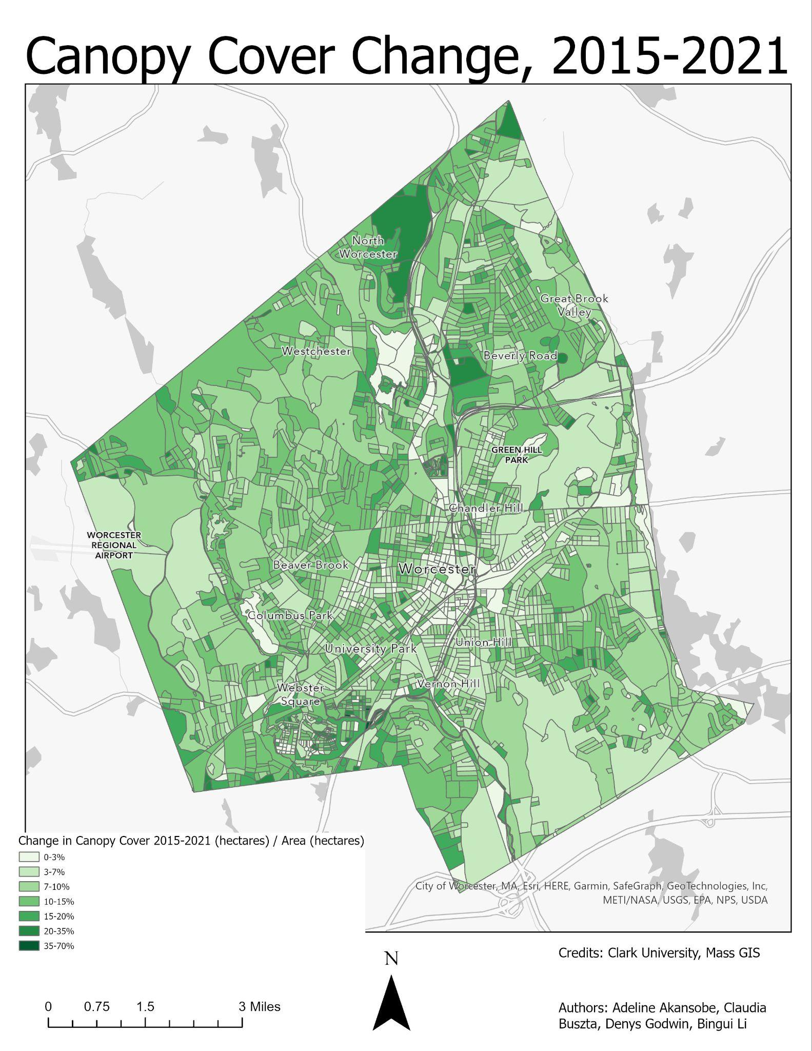
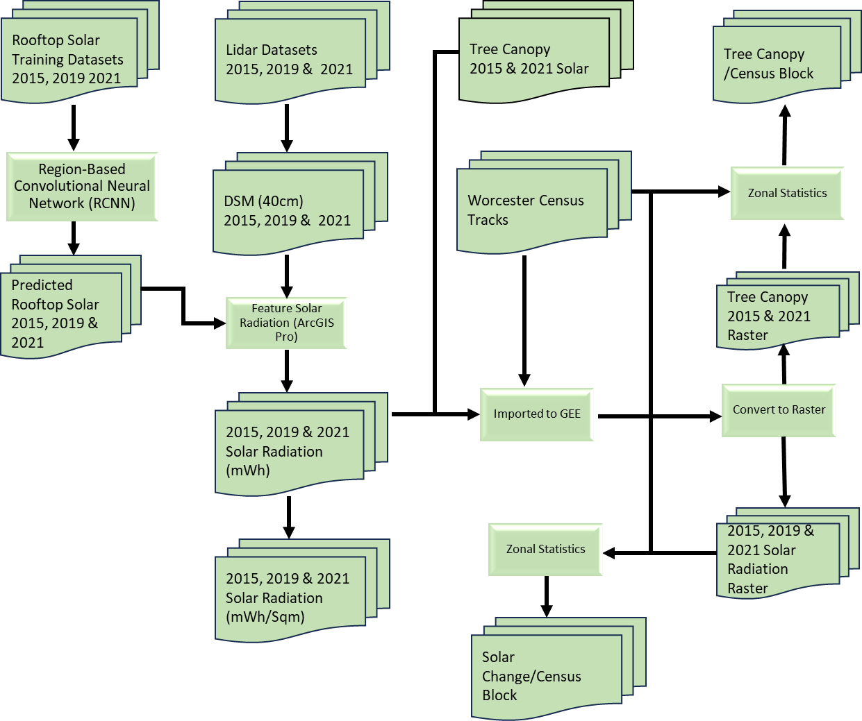
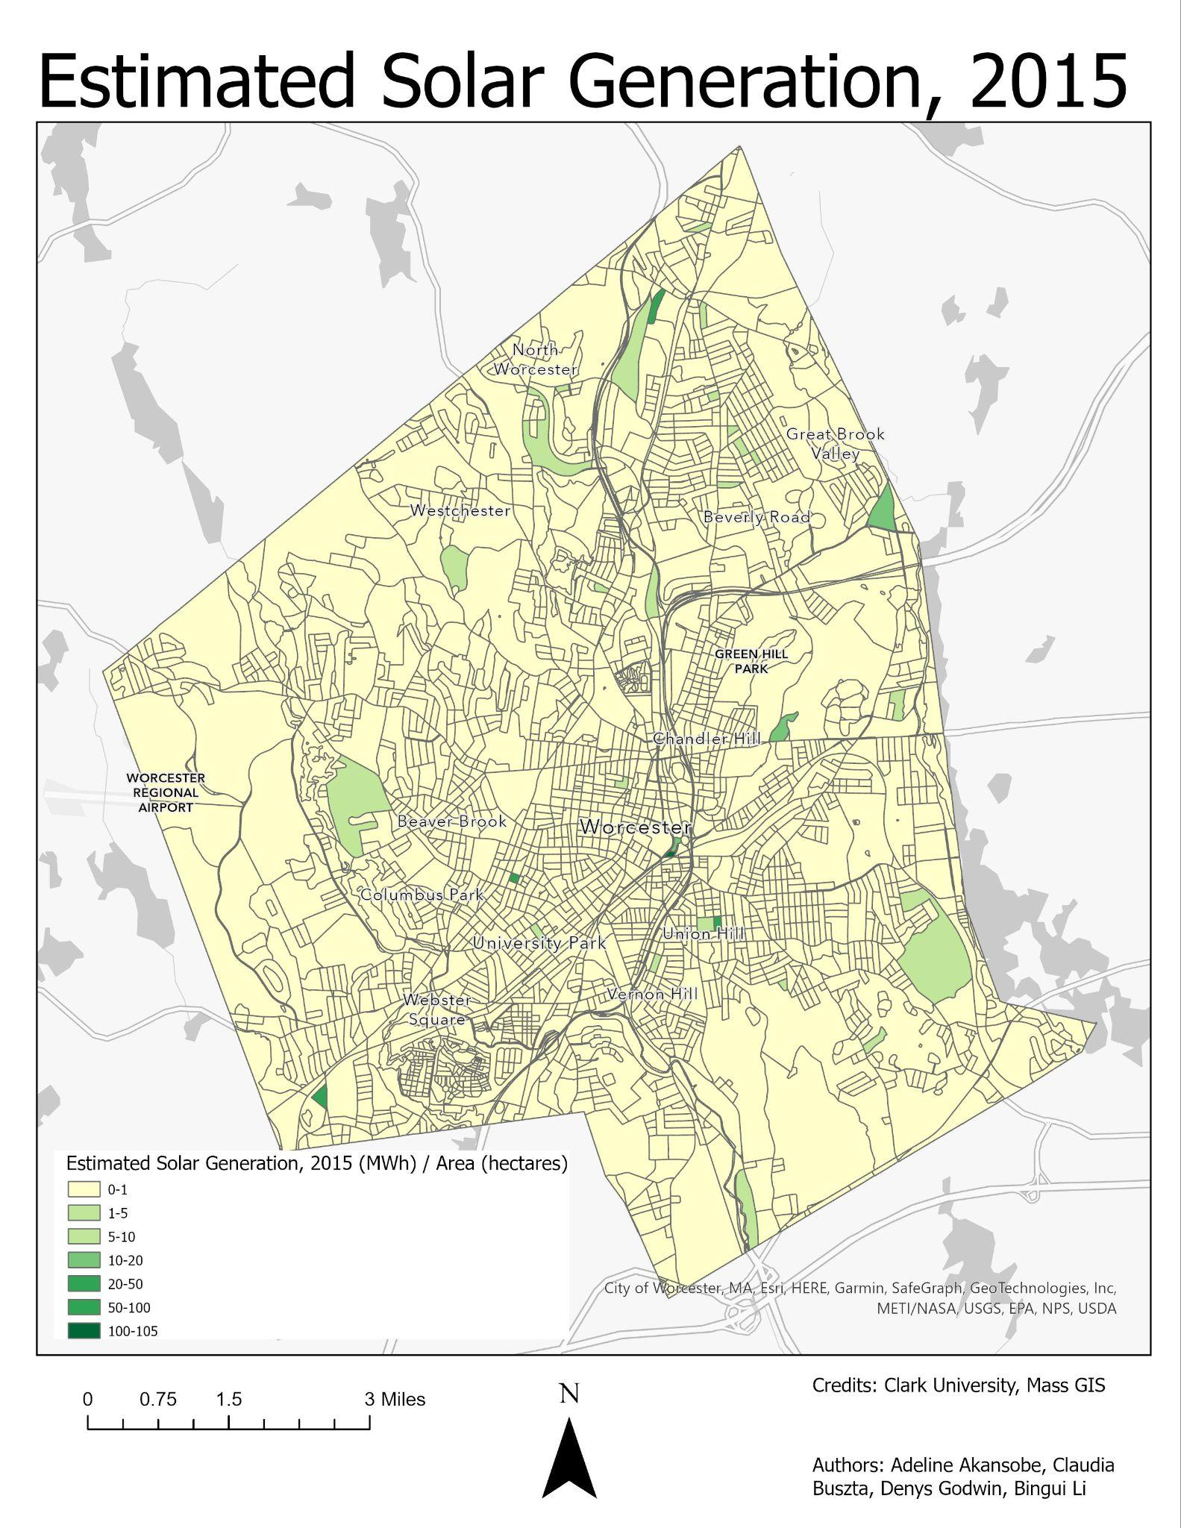
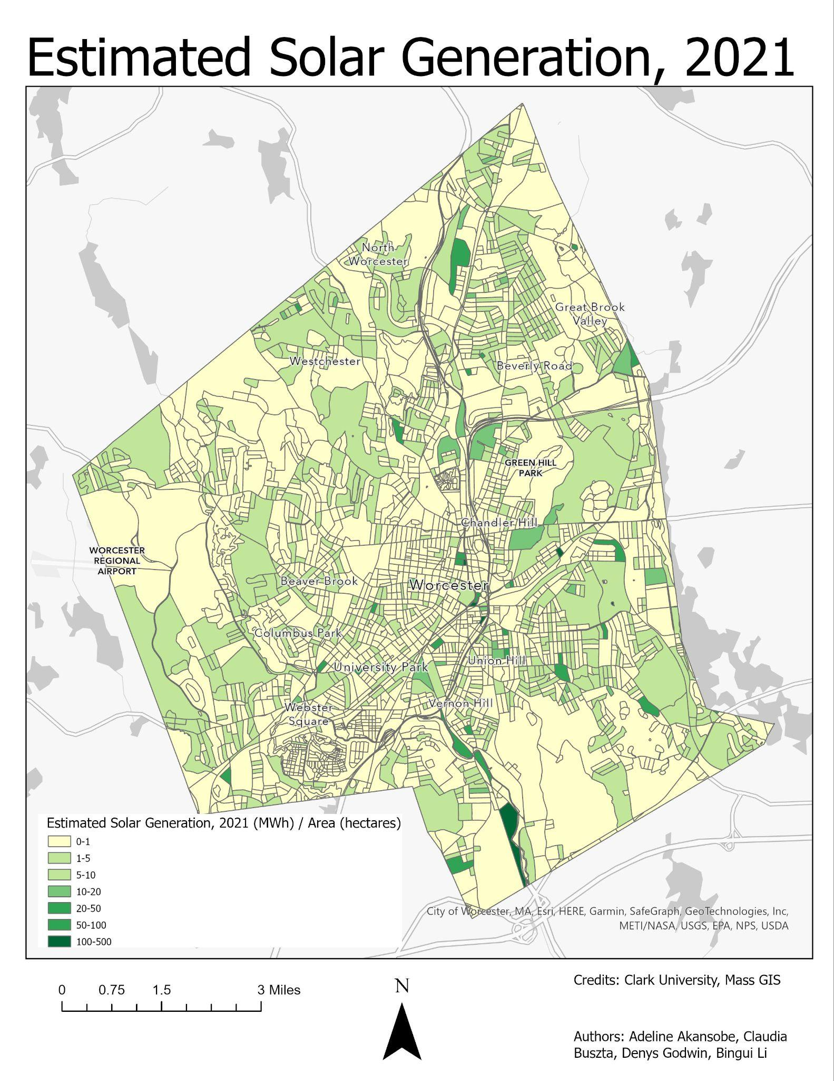
Mapping Rooftop Photovoltaic Panels & Assessing the Suitability of Building Rooftops for Photovoltaic Installation in Worcester, MA
Adeline Akansobe, Claudia Buszta, Denys Godwin, Binghui Li
Introduction
Governments worldwide are reshaping energy policies to combat climate change, transitioning from conventional to renewable energy sources. This has increased global reliance on renewables between 8-10% which aligns with environmental goals and presents socio-economic benefits (Shivanshu (2020) ). Solar energy, notably rooftop installations, plays a pivotal role, with urban areas increasingly adopting them. However, their efficacy depends on factors like building suitability, often overlooked in assessments. Our project, focused on Worcester, Massachusetts, utilized high-resolution datasets and adapted methodologies to identify, evaluate, and analyze rooftop solar panels. The project mapped rooftop solar panels in Worcester, developed an MCE model, and assessed solar potential and impacts. Our Research questions explored electricity capacity, rate of change, spatial distribution patterns, and tree canopy cover changes. The project provided insights into solar adoption patterns, suitability, and potential environmental impacts.
Results
Discussions
There was a rapid increase in solar panel installations from 2015-2021 with an increase in total area of solar panels and power output estimates increased for each consecutive year. Number of solar panels decreased from 2019 to 2021.
Rate of increases from 2015 to 2019 was higher than 2019 to 2021, thus installation reduced but increase in output likely to be solar upgrades.
Tree canopy decreased by 22,775 hectares from 2015 to 2021. This number, while much larger proportionately than the area of increase in solar panels, also includes trees removed for urban development.
Relationship between Solar Generation Change and Canopy Cover Change, 2015-2021
Change in Canopy Cover, 2015-2021 (Proportion of Total Area)
Predicted 2019 Solar Output (MHh)
Change in Solar Generation, 2015-2021, MWh / hectare
Solar Power (MWh/Sqm)
2021
2019
2015
Conclusions
Over the last six years in Worcester, solar panel installations have surged, contributing to increased total area and power output estimates. Despite a decrease in the number of solar panels from 2019 to 2021, likely due to data inaccuracies, the growth rate has slowed, possibly influenced by the higher initial count in 2019. Concurrently, tree canopy cover decreased significantly by 22,775 hectares from 2015 to 2021, reflecting a complex interplay of natural changes and urban development.
The results of the regression analysis between the change in tree canopy (2015-2021) and the change in solar generation per census block indicate a negative correlation.
Canopy Cover, 2015
Data and Methodology
References
Massachusetts Executive Office of Energy and Environmental Affairs (EEA). (2023). Tree Canopy 2016 [Data set]. Massachusetts Executive Office of Energy and Environmental Affairs (EEA). https://hub.arcgis.com/maps/Mass-EOEEA::tree-canopy-2016-1/explore?location=42.247829%2C-71.801058%2C15.16
MassGIS (Bureau of Geographic Information). (2023). MassGIS Data: Building Structures (2-D) [Data set]. Commonwealth of Massachusetts. https://www.mass.gov/info-details/massgis-data-building-structures-2-d
MassGIS (Bureau of Geographic Information). (2023). MassGIS Data: 2021 Aerial Imagery. [Data set]. Commonwealth of Massachusetts. https://www.mass.gov/info-details/massgis-data-2021-aerial-imagery
MassGIS (Bureau of Geographic Information). (2023). MassGIS Data: 2019 Aerial Imagery. [Data set]. Commonwealth of Massachusetts. https://www.mass.gov/info-details/massgis-data-2019-aerial-imagery
MassGIS (Bureau of Geographic Information). (2023). MassGIS Data: 2014 Aerial Imagery. [Data set]. Commonwealth of Massachusetts. https://www.mass.gov/info-details/massgis-data-2014-aerial-imagery
Shivanshu, D. (2020). Solar technologies and their implementations: A review, Journal home page for Materials Today: Proceedings, Volume 28, Part 4, 2020, Pages 2137-2148, https://doi.org/10.1016/j.matpr.2020.04.134.
US EPA. (2023). Green Power Equivalency calculator - calculations and references. https://www.epa.gov/green-power-markets/green-power-equivalency-calculator-calculations-and-references
USGS. (2023). Central/Eastern Lidar Point Cloud. [Data set]. United States government. https://rockyweb.usgs.gov/vdelivery/Datasets/Staged/Elevation/LPC/Projects/MA_CentralEastern_2021_B21/MA_CentralEastern_1_2021/LAZ/
Year | Identified Rooftop Solar Patches | Solar Panel Area (m²) | Estimated Power Output (MWh) | Total Available Solar Energy (MWh)
2015 | 128 | 25,977 | 2,100 | 15,262
2019 | 2,944 | 213,378 | 16,265 | 118,206
2021 | 2,870 | 232,649 | 17,881 | 129,950
Year | Tree Canopy Area (Hectares)
2021 | 4,002.01
2015 | 3,430.90

